Slide 1
A First Book of ANSI C Fourth Edition
Chapter 4
Selection

Slide 2
Objectives
Relational Expressions
The if and if-else Statements
The if-else Chain
The switch Statement
Case Study: Data Validation
Common Programming and Compiler Errors

Slide 3
Introduction
Flow of control refers to the order in which a program’s statements are executed
Any algorithm can be built using combinations of four standardized flow of control structures:
Normal flow of control for all programs is sequential
Selection is used to select which statements are performed next based on a condition
Repetition is used to repeat a set of statements
Invocation is used to invoke a sequence of instructions using a single statement, as in calling a function
Notes:
standardized英 ['stændədaɪzd]

Slide 4
Relational Expressions
Simplest decision structure:
if (condition)
statement executed if condition is true
The condition is evaluated to determine its numerical value, which is interpreted as either true (non-zero) or false (0)
If condition is “true” the statement following the if is executed; otherwise, statement is not executed
The condition used in all of C’s if statements can be any valid C expression
Most commonly, a relational expression (can yield only 0 or 1)
Notes:
Relational expression 关系表达式

Slide 5
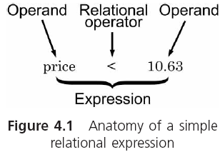
Relational Expressions (continued)
a relational expression can yield only 0 or 1
Notes:
Operand 操作数， 运算对象 anatomy 英 [əˈnætəmin. 解剖，分解，分析;

Slide 6
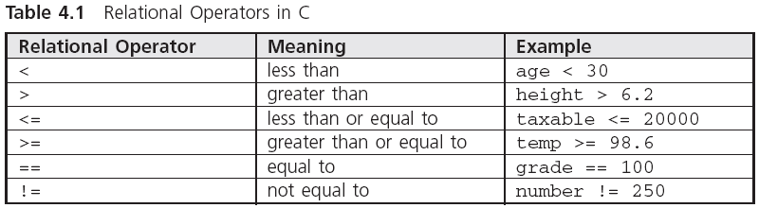
Relational Expressions (continued)

Slide 7
Relational Expressions (continued)
Relational expressions are also known as conditions
A relational expression evaluates to 1 (true) or 0 (false)
The expression 3 < 4 has a value of 1
The expression 2.0 > 3.3 has a value of 0
The value of hours > 0 depends on the value of hours
Character data can also be compared using relational operators
Notes:
字符集都是按照升序或降序排列。B>A

Slide 8
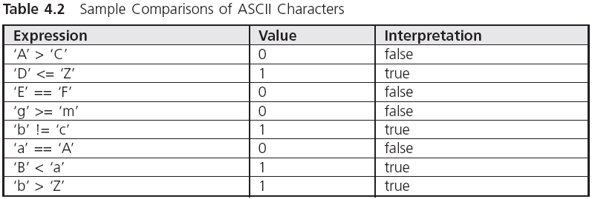
Relational Expressions (continued)
Notes:
ASCII 码，A-Z 然后才是a-z; A 是65， C是67，a是97
在计算机中，所有的数据在存储和运算时都要使用二进制数表示（因为计算机用高电平和低电平分别表示1和0），例如，像a、b、c、d这样的52个字母（包括大写）、以及0、1等数字还有一些常用的符号（例如*、#、@等）在计算机中存储时也要使用二进制数来表示，而具体用哪些二进制数字表示哪个符号，当然每个人都可以约定自己的一套（这就叫编码），而大家如果要想互相通信而不造成混乱，那么大家就必须使用相同的编码规则，于是美国有关的标准化组织就出台了ASCII编码，

Slide 9

用if语句处理选择结构举例
输入两个实数，按代数值由小到大的顺序输出这两个数。

Slide 10
用if语句处理选择结构举例
解题思路：
只需要做一次比较，然后进行一次交换即可
用if语句实现条件判断
关键是怎样实现两个变量值的互换
★
●
互换前
A
B
●
★
互换后
A
B

Slide 11
用if语句处理选择结构举例
C
★
★
●
A
B

Slide 12
用if语句处理选择结构举例
C
★
★
●
A
●
B

Slide 13
用if语句处理选择结构举例
C
★
●
A
●
★
B

Slide 14

#include <stdio.h>
int main()
{ float a,b,t;
scanf("%f,%f",&a,&b);
if(a>b)
{ t=a;
a=b;
b=t;
}
printf("%5.2f,%5.2f\n",a,b);
return 0;
}
如果a>b
将a和b的值互换

Slide 15
#include <stdio.h>
int main()
{ float a,b,t;
scanf("%f,%f",&a,&b);
if(a>b)
{ t=a;
a=b;
b=t;
}
printf("%5.2f,%5.2f\n",a,b);
return 0;
}
选择结构，用if语句实现的

Slide 16
输入3个数a，b，c，要求按由小到大的顺序输出。

Slide 17
解题思路：可以先用伪代码写出算法：
if a>b，a和b对换 （a是a、b中的小者）
if a>c，a和c对换 （a是三者中最小者）
if b>c，b和c对换 （b是三者中次小者）
顺序输出a，b，c

Slide 18
#include <stdio.h>
int main()
{ float a,b,c,t;
scanf("%f,%f,%f",&a,&b,&c);
if(a>b)
{ t=a; a=b; b=t; }
if(a>c)
{ t=a; a=c; c=t; }
if(b>c)
{ t=b; b=c; c=t; }
printf("%5.2f,%5.2f,%5.2f\n",a,b,c);
return 0;
}
如果 a>b，将a和b对换
a是a、b中的小者

Slide 19
#include <stdio.h>
int main()
{ float a,b,c,t;
scanf("%f,%f,%f",&a,&b,&c);
if(a>b)
{ t=a; a=b; b=t; }
if(a>c)
{ t=a; a=c; c=t; }
if(b>c)
{ t=b; b=c; c=t; }
printf("%5.2f,%5.2f,%5.2f\n",a,b,c);
return 0;
}
如果 a>c，将a和c对换
a是三者中的小者

Slide 20

#include <stdio.h>
int main()
{ float a,b,c,t;
scanf("%f,%f,%f",&a,&b,&c);
if(a>b)
{ t=a; a=b; b=t; }
if(a>c)
{ t=a; a=c; c=t; }
if(b>c)
{ t=b; b=c; c=t; }
printf("%5.2f,%5.2f,%5.2f\n",a,b,c);
return 0;
}
如果 b>c，将b和c对换
b是三者中的次小者

Slide 21
Logical Operators
More complex conditions can be created using the logical operations AND (&&), OR (||), and NOT (!)
When the && is used with two expressions, the condition is true only if both expressions are true by themselves
Relational operators have a higher precedence than logical operators.

Slide 22
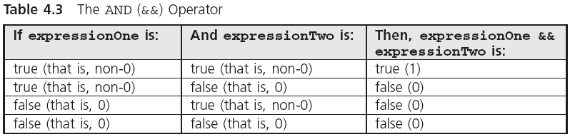
Logical Operators (continued)

Slide 23
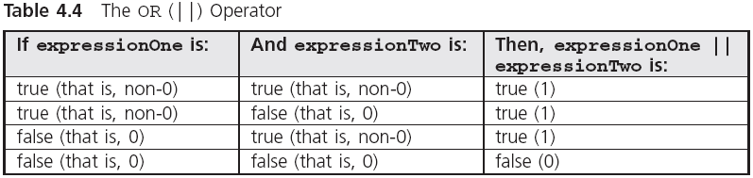
Logical Operators (continued)
Notes:
或运算是只有两个都是假，结果才是假

Slide 24
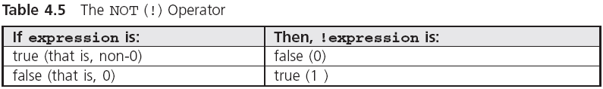
Logical Operators (continued)
Notes:
只能用于单表达式。

Slide 25
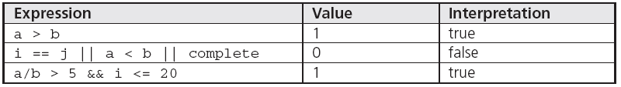
Logical Operators (continued)
int i = 15, j = 30;
double a = 12.0, b = 2.0, complete = 0.0;
Notes:
在计算条件式之前，变量a,b,I,j和complete的值必须已知。 Complete =0.0 取整数为0 ，也就是条件值为假

Slide 26
Logical Operators (continued)
The evaluation feature for the && and || operators that makes the evaluation of an expression stop as soon as it is determined that an expression is false is known as short-circuit evaluation
Parentheses can be used to alter the assigned operator priority
(6 * 3 == 36 / 2) && (13 < 3 * 3 + 4) || !(6 - 2 < 5) =
(18 == 18) && (13 < 9 + 4) || !(4 < 5) =
1 && (13 < 13) || !1 =
1 && 0 || 0 =
0 || 0 =
0
Notes:
&& 与|| 结合性都是从左到右。 &&比||优先级 高 circuit 英 [ˈsɜ:kɪt]
1 && 与||的求值特性，也就是一旦能够决定表达式的值为假，表达式的计算就停止了。这种特性叫做短路求值。

Slide 27
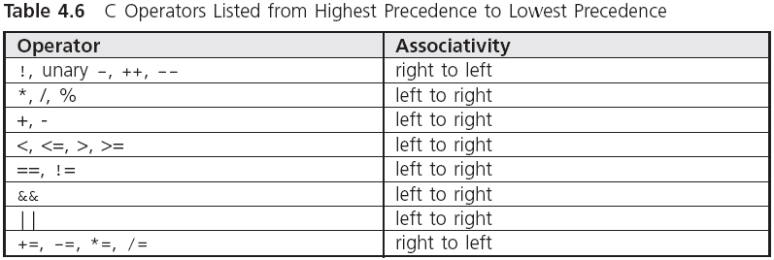
Logical Operators (continued)
precedence
highest
lowest

Slide 28
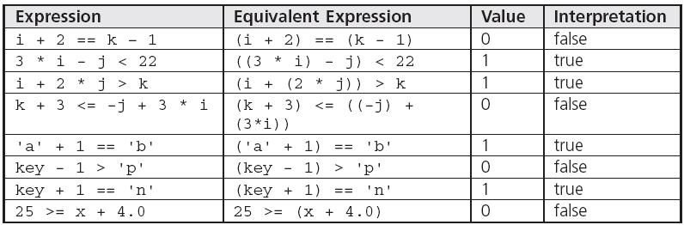
Logical Operators (continued)
m的ASCII码是109
char key = 'm';
int i = 5, j = 7, k = 12;
double x = 22.5;
l
Notes:
Equlvalent 相同的，等价的 m在ASCII码里是109， 109-1=108 是小写字母 L ； p的码是112

Slide 29
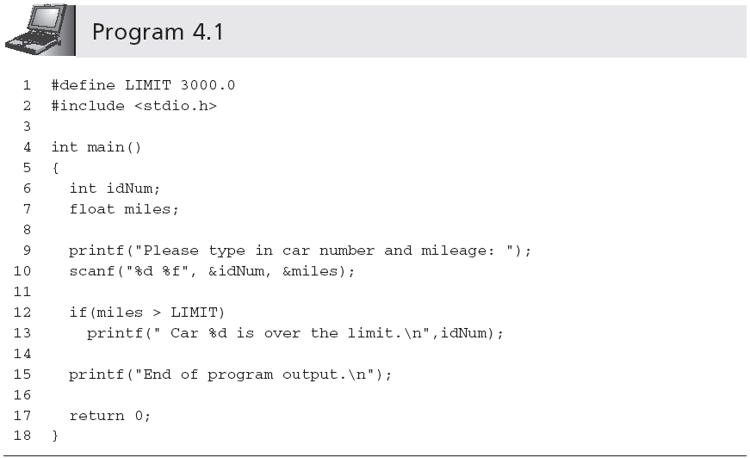
The if and if-else Statements
No semicolon here
One-way if statement
256 3562.8
23 2562.3

Slide 30
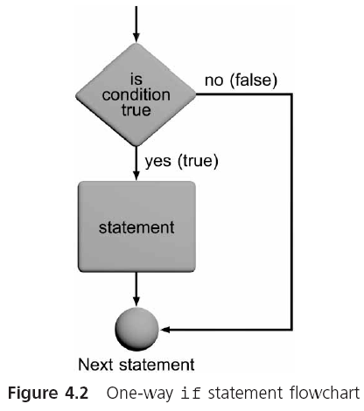
The if and if-else Statements

Slide 31
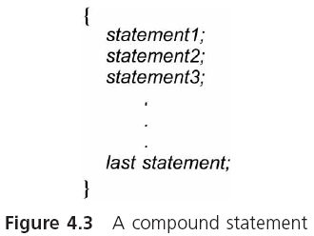
Compound Statements
Although only a single statement is permitted in an if statement, this statement can be a single compound statement
Notes:
Compound Statements 复合语句 放在一组大括号内。

Slide 32
Compound Statements (continued)
For example,
if (expression)
{
statement 1; /*as many statements as necessary*/
statement 2; /*can be placed within the braces*/
• /*each statement must end with ; */
•
•
statement n;
}
For very short statements, you can code a complete if statement placed on a single line
if (grade > 69) ++passTotal;

Slide 33
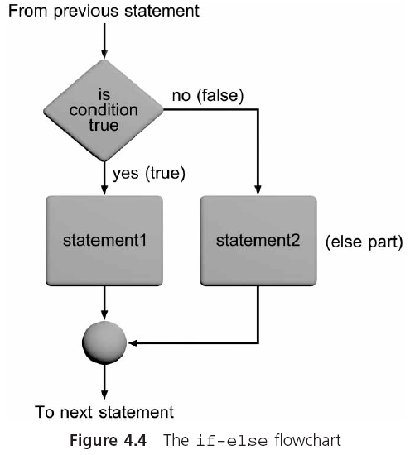
The if-else Statement
The most commonly used if-else statement is
if (expression)
statement1;
else
statement2;
If the value of expression is 0 ，the statement （statement2) after the reserved word else, is executed

Slide 34
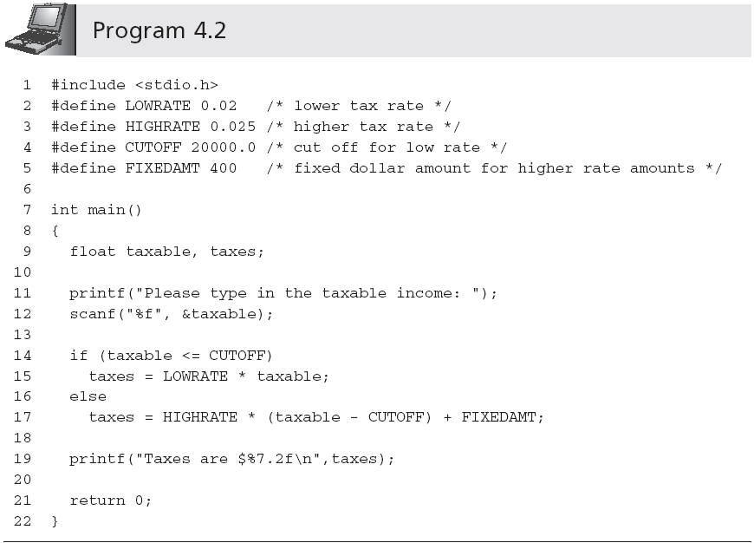
The if-else Statement (continued)
Notes:
函数名: scanf
功 能: 执行格式化输入
用 法: int scanf(char *format[,argument,...]);
scanf()函数是通用终端格式化输入函数，它从标准输入设备(键盘) 读取输入的信息。可以读入任何固有类型的数据并自动把数值变换成适当的机内格式。
其调用格式为: scanf("<格式化字符串>"，<地址表>);
scanf()函数返回成功赋值的数据项数，出错时则返回EOF。
其控制串由三类字符构成：
1。格式化说明符；
2。空白符；
3。非空白符；
（A） 格式化说明符
格式字符 说明
%a 读入一个浮点值(仅C99有效)
%A 同上
%c 读入一个字符
%d 读入十进制整数
%i 读入十进制，八进制，十六进制整数
%o 读入八进制整数
%x 读入十六进制整数
%X 同上
%c 读入一个字符
%s 读入一个字符串
%f 读入一个浮点数
%F 同上
%e 同上
%E 同上
%g 同上
%G 同上
%p 读入一个指针
%u 读入一个无符号十进制整数
%n 至此已读入值的等价字符数
%[] 扫描字符集合
%% 读%符号
附加格式说明字符表
修饰符 说明
L/l 长度修饰符 输入"长"数据
h 长度修饰符 输入"短"数据
W 整型常数 指定输入数据所占宽度
* 星号 空读一个数据
hh,ll同上h,l但仅对C99有效。
（B） 空白字符
空白字符会使scanf()函数在读操作中略去输入中的一个或多个空白字符，空白符可以是space,tab,newline等等，直到第一个非空白符出现为止。
（C） 非空白字符
一个非空白字符会使scanf()函数在读入时剔除掉与这个非空白字符相同的字符。

Slide 35
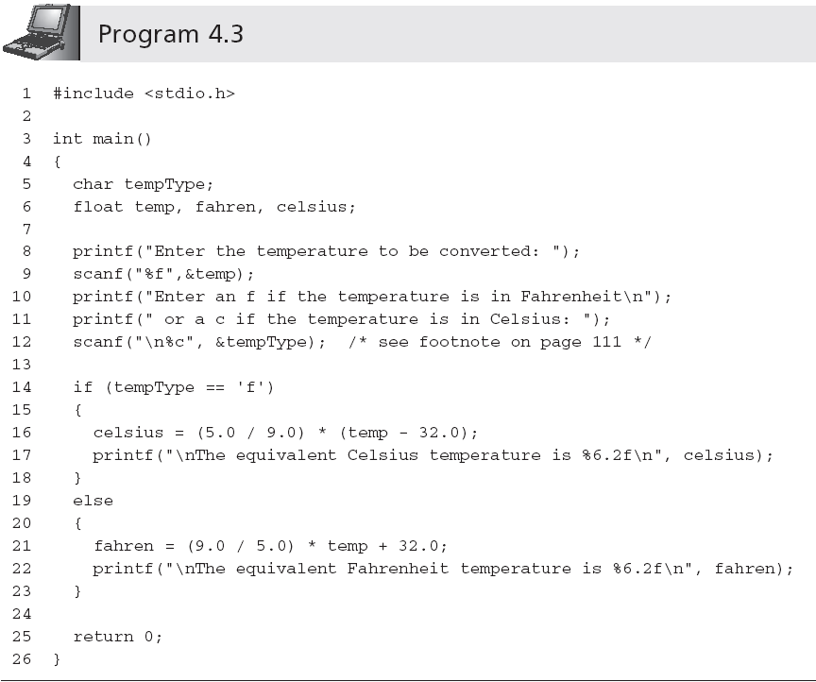
The if-else Statement (continued)
Notes:
因为上一个数值输入结束的时候使用回车符结束，回车符进入了缓冲区。所以当下一个接收字符的时候，如果SCANF（没有\n）那么，tempType就是回车符。所以不执行if语句，执行else

Slide 36

选择结构和条件判断
求  方程的根。
由键盘输入a,b,c。假设a,b,c的值任意，并不保证 。需要在程序中进行判别，如果 ， 就 计算并输出方程的两个实根，否则就输出“方程无实根”的信息。

Slide 37
解题思路：
输入a,b,c
计算disc
真
disc<0
假
计算x₁,x₂
输出无实根
输出x₁,x₂

Slide 38
#include <stdio.h>
#include <math.h>
int main ( )
{
double a,b,c,disc,x1,x2,p,q;
scanf("%lf%lf%lf",&a,&b,&c);
disc=b*b-4*a*c;
计算b²-4ac，disc的值变为-15

Slide 39
-15<0为真
if (disc<0)
printf(“has not real roots\n”);
else
{ p=-b/(2.0*a);
q=sqrt(disc)/(2.0*a);
x1=p+q;
x2=p-q;
printf(“real roots:\nx1=%7.2f\n
x2=%7.2f\n”,x1,x2);
}
return 0;
}

Slide 40
#include <stdio.h>
#include <math.h>
int main ( )
{
double a,b,c,disc,x1,x2,p,q;
scanf("%lf%lf%lf",&a,&b,&c);
disc=b*b-4*a*c;
计算b²-4ac，disc的值变为8

Slide 41

8<0为假
if (disc<0)
printf(“has not real roots\n”);
else
{ p=-b/(2.0*a);
q=sqrt(disc)/(2.0*a);
x1=p+q;
x2=p-q;
printf(“real roots:\nx1=%7.2f\n
x2=%7.2f\n”,x1,x2);
}
return 0;
}
p的值变为-1
q的值变为0.71
x1的值变为-0.29
x2的值变为-1.71

Slide 42
if (disc<0)
printf(“has not real roots\n”);
else
{ p=-b/(2.0*a);
q=sqrt(disc)/(2.0*a);
x1=p+q;
x2=p-q;
printf(“real roots:\nx1=%7.2f\n
x2=%7.2f\n”,x1,x2);
}
return 0;
}
选择结构，用if语句实现的

Slide 43
if (disc<0)
printf(“has not real roots\n”);
else
{ p=-b/(2.0*a);
q=sqrt(disc)/(2.0*a);
x1=p+q;
x2=p-q;
printf(“real roots:\nx1=%7.2f\n
x2=%7.2f\n”,x1,x2);
}
return 0;
}
复合语句

Slide 44
The if-else Chain
Nested if statement:
if (expression1)
statement1;
else
if (expression2)
statement2;
else
statement3;
Whether the indentation exists or not, the compiler will, by default, associate an else with the closest previous unpaired if, unless braces are used to alter this default pairing
Notes:
Nested 嵌套的，内装的
是否存在缩进，编译器将在缺省情况下，将与最接近未配对的if 与一个else关联,除非使用括号来改变这种默认配对

Slide 45
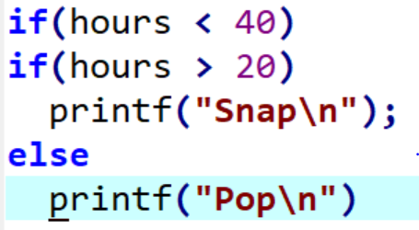
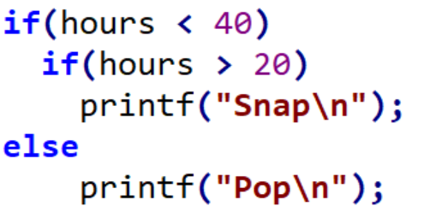
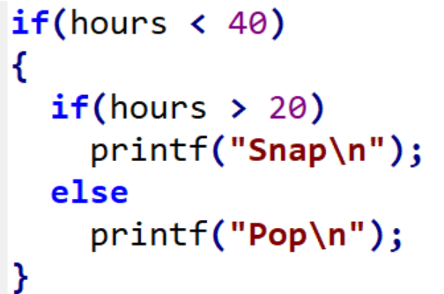
×
You want to indent the format:
The code will actually compiled as

Slide 46
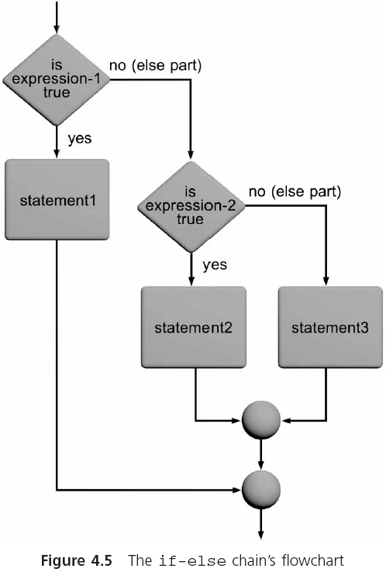
The if-else Chain (continued)
if-else chain:
if (expression1)
statement1;
else if (expression2)
statement2;
else if (expression3)
statement3;
.
.
else
statement4;

Slide 47
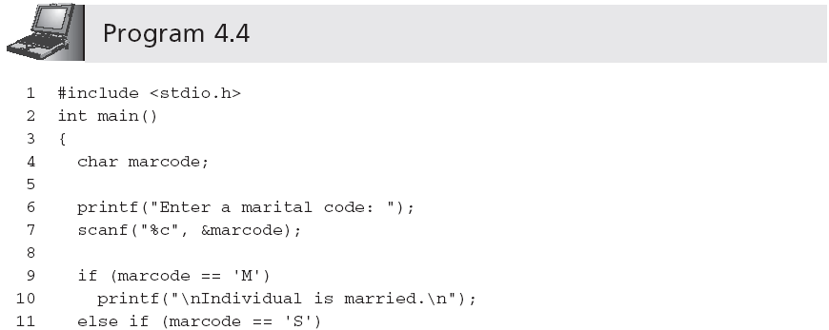
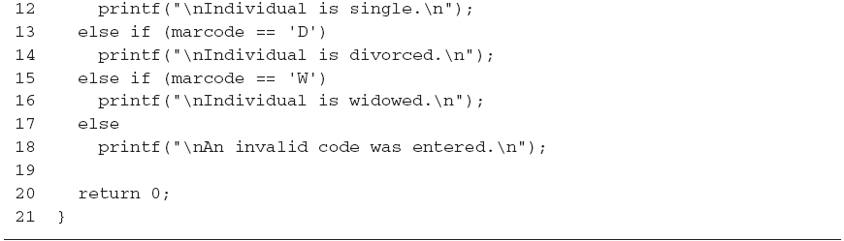
The if-else Chain (continued)

Slide 48
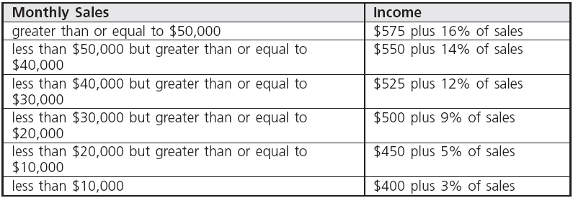
The if-else Chain (continued)

Slide 49
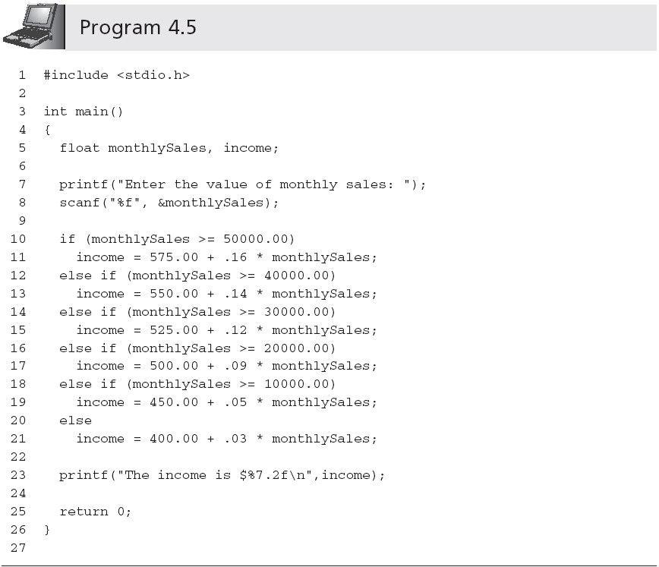
The if-else Chain (continued)

Slide 50
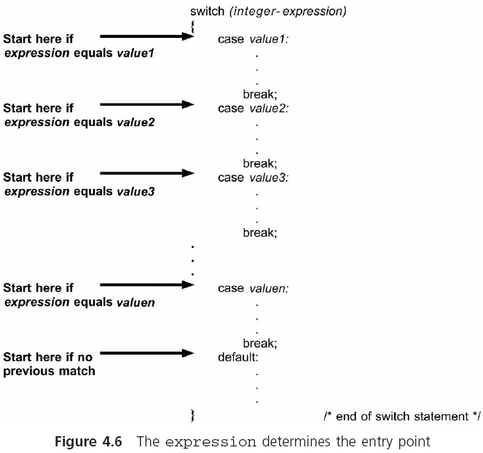
The switch Statement
Terminated with a colon
If the break statement was omitted, the following case would be executed
default is optional
Notes:
使用了四个关键字，switch ， case， break， default

Slide 51
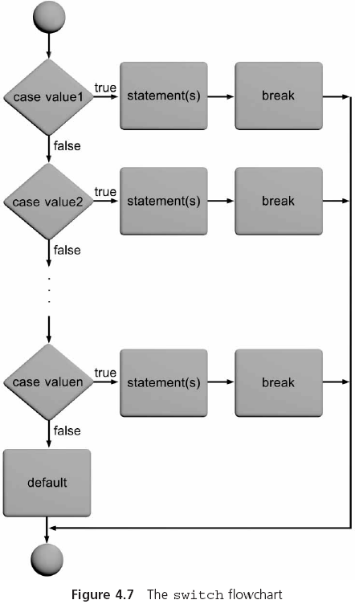
The switch Statement (continued)

Slide 52
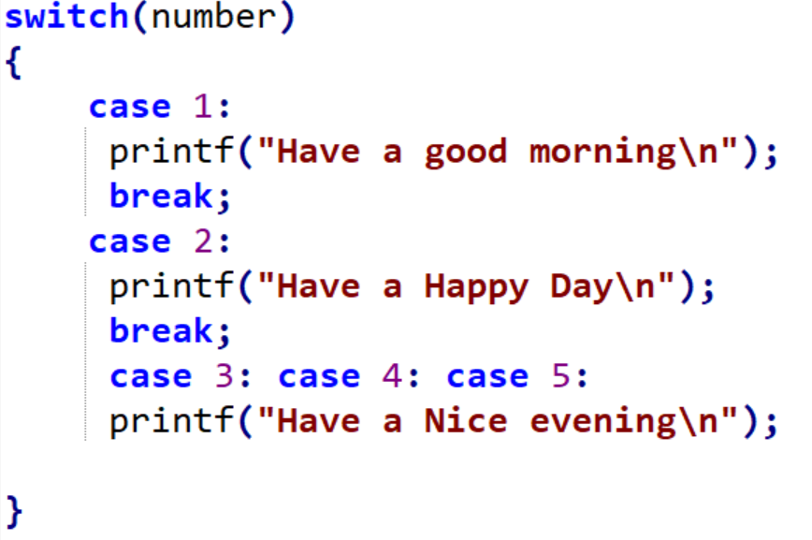

Slide 53
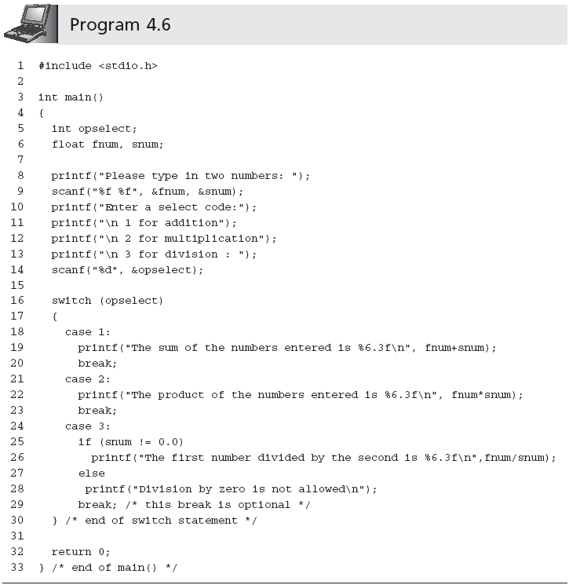
The switch Statement (continued)

Slide 54
#include <stdio.h>
int main()
{ char grade;
scanf("%c",&grade);
printf("Your score:");
switch(grade)
{ case 'A': printf("85～100\n");break;
case 'B': printf("70～84\n");break;
case 'C': printf("60～69\n");break;
case 'D': printf("<60\n");break;
default: printf("enter data error!\n");
}
return 0;
}
值为A

Slide 55
#include <stdio.h>
int main()
{ char grade;
scanf("%c",&grade);
printf("Your score:");
switch(grade)
{ case 'A': printf("85～100\n");break;
case 'B': printf("70～84\n");break;
case 'C': printf("60～69\n");break;
case 'D': printf("<60\n");break;
default: printf("enter data error!\n");
}
return 0;
}
不能少

Slide 56
#include <stdio.h>
int main()
{ char grade;
scanf("%c",&grade);
printf("Your score:");
switch(grade)
{ case 'A': printf("85～100\n");break;
case 'B': printf("70～84\n");break;
case 'C': printf("60～69\n");break;
case 'D': printf("<60\n");break;
default: printf("enter data error!\n");
}
return 0;
}
值为C

Slide 57
#include <stdio.h>
int main()
{ char grade;
scanf("%c",&grade);
printf("Your score:");
switch(grade)
{ case 'A': printf("85～100\n");break;
case 'B': printf("70～84\n");break;
case 'C': printf("60～69\n");break;
case 'D': printf("<60\n");break;
default: printf("enter data error!\n");
}
return 0;
}
值为F

Slide 58
#include <stdio.h>
int main()
{ char grade;
scanf("%c",&grade);
printf("Your score:");
switch(grade)
{ case 'A': printf("85～100\n");break;
case 'B': printf("70～84\n");break;
case 'C': printf("60～69\n");break;
case 'D': printf("<60\n");break;
default: printf("enter data error!\n");
}
return 0;
}

Slide 59
switch语句的作用是根据表达式的值，使流程跳转到不同的语句
switch语句的一般形式：
switch（表达式）
{ case 常量1 ：语句1
case 常量2 ：语句2
┇ ┇ ┇
case 常量n ：语句n
default : 语句n+1
}
整数类型(包括字符型)

Slide 60
switch语句的作用是根据表达式的值，使流程跳转到不同的语句
switch语句的一般形式：
switch（表达式）
{ case 常量1 ：语句1
case 常量2 ：语句2
┇ ┇ ┇
case 常量n ：语句n
default : 语句n+1
}
不能相同

Slide 61

scanf("%c",&grade);
printf("Your score:");
switch(grade)
{ case 'A': printf("85～100\n");break;
case 'B': printf("70～84\n");break;
case 'C': printf("60～69\n");break;
case 'D': printf("<60\n");break;
default: printf("enter data error!\n");
}

Slide 62
scanf("%c",&grade);
printf("Your score:");
switch(grade)
{ case 'A': printf("85～100\n");break;
case 'B': printf("70～84\n");break;
case 'C': printf("60～69\n");break;
case 'D': printf("<60\n");break;
default: printf("enter data error!\n");
}

Slide 63

scanf("%c",&grade);
printf("Your score:");
switch(grade)
{ case 'A‘:
case 'B‘:
case 'C': printf("60～69\n");break;
case 'D': printf("<60\n");break;
default: printf("enter data error!\n");
}

Slide 64
Case Study: Data Validation
Defensive programming is a technique where the program includes code to check for improper data before an attempt is made to process it further
Checking user input data for erroneous or unreasonable data is called input data validation
Notes:
防御性编程是一种技术，在试图进一步处理它之前，程序包括代码用来检查不正确数据
检查用户输入数据错误或不合理的数据称为输入数据的验证。 erroneous英 [ɪˈrəʊniəs]
需求： reciprocal 相互的，倒数
编写一个程序计算平方根的倒数用户输入的号码。有效的是数字取它的平方根之前取它的平方根不能是负数，计算数的倒数之前数字不能是0。

Slide 65
Requirements:
Write a program to calculate the square root and the reciprocal of a user-entered number.
Validate that the number is not negative before attempting to take its square root
and that the number is not 0 before calculating the number’s reciprocal value.
Notes:
reciprocal英 [rɪˈsɪprəkl]

Slide 66
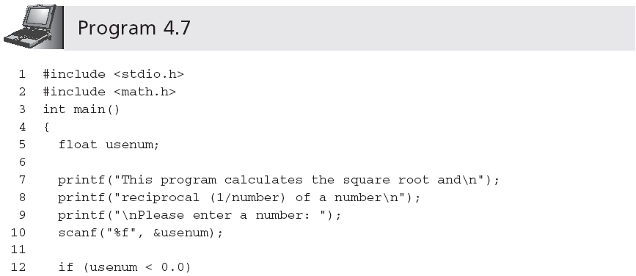
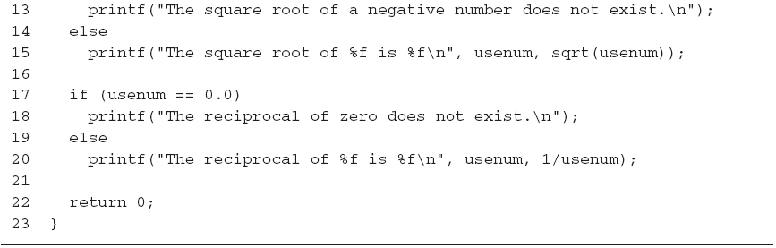
Case Study: Data Validation (continued)

Slide 67
Common Programming Errors
Using the assignment operator, =, in place of the relational operator, ==
Letting the if-else statement appear to select an incorrect choice
Nesting if statements without including braces to clearly indicate the desired structure
Using a single & or | in place of the logical && and logical || operators, respectively
Notes:
使用赋值运算符=代替 ==关系操作符的地方
让if - else语句似乎选择一个错误的选择
if语句嵌套不包括括号，来清晰地标明所需的结构
使用单一&或I 来代替逻辑运算符&&或| | 运算符

Slide 68
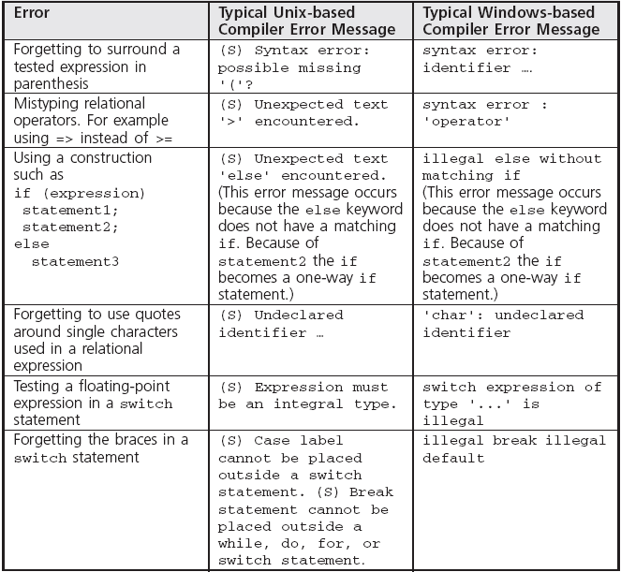
Common Compiler Errors

Slide 69
Summary
Relational expressions, which are also called simple conditions, are used to compare operands
Conditions can be constructed from relational expressions using C’s logical operators, &&, ||, and !
A one-way if statement has the general form
if (expression)
statement;
A compound statement consists of any number of individual statements enclosed within braces
An if-else selects between two alternative statements based on the value of an expression

Slide 70
Summary (continued)
An if-else statement can contain other if-else statements
The if-else chain is a multiway selection statement
The switch statement is a multiway selection statement; program execution is transferred to the first matching case and continues through the end of the switch statement unless an optional break statement is encountered
Notes:
switch语句是一个多路选择语句,程序执行转移到第一个匹配的情况下,持续到年底switch语句,除非遇到一个可选的break语句

Slide 71
练习
（1）用户输入年月时，显示这个月有多少天（使用if 语句 或 switch语句）；
可选练习（扩展），用户输入当前日期，显示这个月的天数，以 及当日是周几。
（2）对学过的内容进行练习，例如
有一函数:
编一程序，输入一个x值，要求输出相应的y值。

